Slide 1
Trajectory & Rotation
IN628 Intermediate Architectures and Algorithms
Semester 2, 2016
Session 8.1

Slide 2
Trajectory of Projectiles
Notes:
Things are always being launched in computer games
We want to animate this

Slide 3
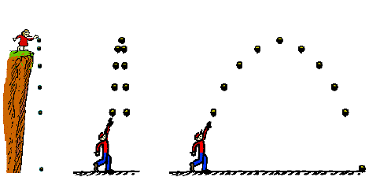
Types of Projectiles
Notes:
There are many different projectile situations, but all can be handled the same way
We move the object similarly to how have always done, by adding an XVel term and a YVel term.
Accurate (or sufficiently accurate) trajectories are created by using the correct function for XVel(t) - xVelocity as a function of time, or how the speed of the object changes as time passes -- and YVel(t)

Slide 4
Projectile Movement
Projectile movement uses a completely different logic than the “directional sprite” movement we have for player characters and NPCs.
For projectile movement, we return to signed velocities.
Initial approach:
Create new method
Eventual approach:
Generate different classes via inheritance
Notes:
Note that when moving projectiles, we don’t use the “directional movement” paradigm we use for walking sprites. Projectiles follow a trajectory that goes north and south over time, so it requires a different logic than does the “take one step in this direction” behaviour of the walking sprites.
Signed velocity means xVel and yVel can be negative, as they were at the beginning. We don’t separate them into magnitude and direction vectors.
You will want to introduce a new method for projectile sprites, and next time, we will discuss how inheritance will help us out with this.
Note that the inheritance decision has some subtlety: You might think that you would just descend your sprite class to DirectionalSprites and ProjectileSprites. However, trajectory is also relevant for directional sprites, e.g. when you want to add jumping.
We will discuss this further when we cover syntax for descent, but you can start thinking about it now.

Slide 5
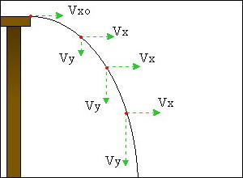
Horizontal and Vertical Velocities
Notes:
The critical thing to remember is that in the real world, over time, horizontal velocity does not change (in the absence of friction, which we will ignore)
Vertical velocity does change, however.
On earth, vertical velocity increases over time due to gravity.
In the figure, note that Vx = Vx0 for all t (i.e. the object moves the same distance in the x-direction at each time unit) but that Vy increases with t (i.e. as time passes, the object moves a larger and larger distance in the y-direction at each time unit – i.e. it falls faster).

Slide 6
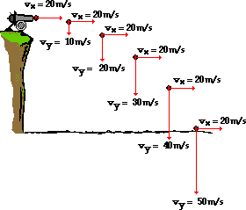
Horizontal and Vertical Velocities
Notes:
The effect is illustrated again here
Note that the acceleration due to gravity is a constant for this planet, and has an actual value (9.8m/s/s).
In games, however, use whatever value makes it look good. This will depend on various things, including the scale of the image

Slide 7
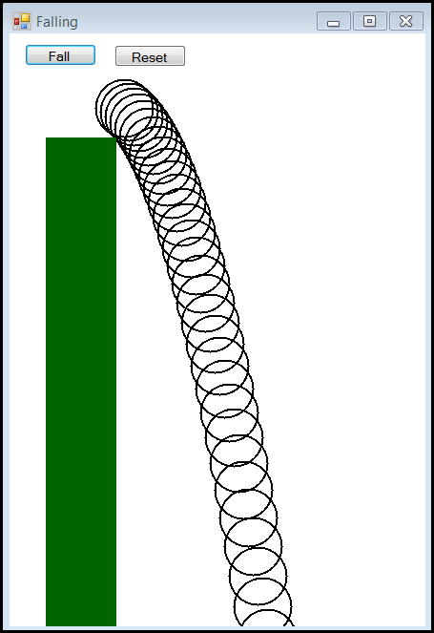
Falling
Notes:
Here’s an example of trajectory code.
The ball starts on top of the pedestal. When the user clicks the button, it falls.
The “ball” is actually just a FillEllipse command at xLoc and yLoc.
xLoc and yLoc are determined using the gravity equations we saw in the previous slides
What we see in this image is the path that it follows, created by leaving its outline at each timer tick
Note the sufficiently realistic arced path.

Slide 8
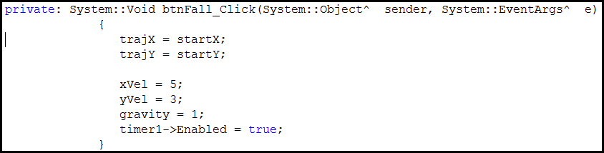
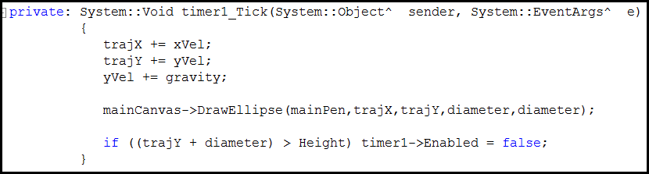
Falling - Code
Notes:
Here’s the code
The start button sets everything up to start from the top of the pedestal with the correct velocities, and turns the timer on
In the timer, we just move the ellipse.
Note that the xVel remains constant, but the yVel is increased by gravity at each time.
This is all the code that is needed to implement the simulation

Slide 9
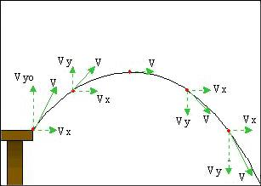
Launching
Notes:
Objects launched upwards have a parabolic trajectory
This is easy to implement.
Simply start with an initial negative Y velocity. Eventually, you will increment it by gravity enough times that it will become positive, and the object will start to fall…..

Slide 10
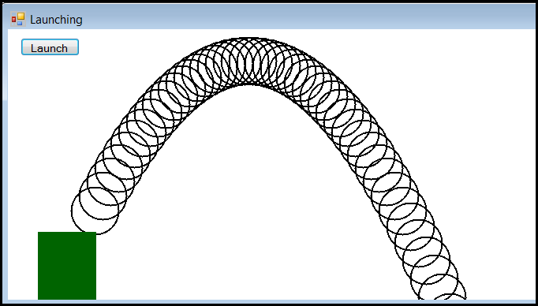
Launching
Notes:
Here is the launching demo

Slide 11
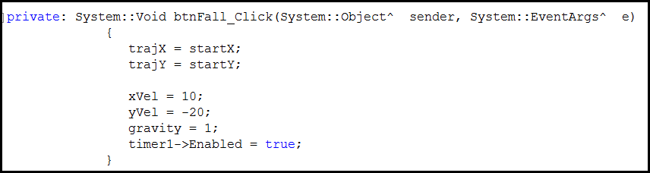
Launching - Code
Notes:
This is the only change. The initial yVel is negative.
Later we will see how to select good values for the initial x and y velocities based on the orientation (angle that you which to launch at) and power (speed that you wish to fly at) of the launching device.

Slide 12
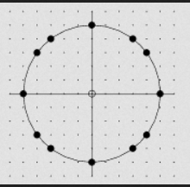
Rotation
Orienting objects in a circular space
Notes:
We have until now always dealt with our objects from a linear perspective – move them so many units along the x-axis, and so many along the y-axis.
Sometimes we got fancy and headed off at 45 degrees, but that was simply achieved by moving them at equal speeds along the x and y axes.
Often, however, we want to deal with objects in, sort of, a circular perspective. For example we might want to turn an object some number of degrees, we might want to rotate an object some number of degrees.
To do these things, we need to think about angles around a circle.
Image from wolfram

Slide 13
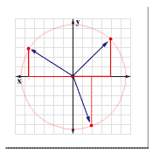
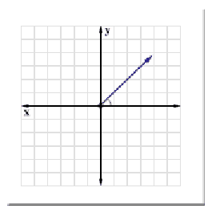
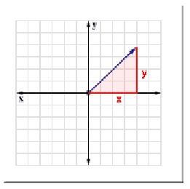
(X,Y) Coordinates and Triangles
Notes:
Note that angles around a circle still have linear components. Every point on the circumference of a circle is just an (x,y) pair with all such pairs being a fixed distance from the origin.
If we think of any point on a circle, we can view it relative to the origin (0,0)
We can think of any point in space this way. Rotated some amount from horizontal, extending some distance.
Its x and y values determine a right triangle with the origin, as illustrated.
The relationships between the angle at the origin, the length of the line, and the lengths of x and y are constant.
That is, for a given angle, the ratios of the length (hypotenuse) and the legs are fixed.
As h gets longer, y and x get longer too, to maintain the angle. For a fixed angle, the ratio of y to h is a constant., and the ratio of x to h is also a constant (usually of a different value).
These constants are known; programming languages have libraries that will tell you what they are (for each possible angle). We use these functions when moving objects in space.

Slide 14

Sine and Cosine
y/hypotenuse = sine(angle)
x/hypotenuse = cosine(angle)
Notes:
As h gets longer, y gets longer too, to maintain the angle. For a fixed angle, the ratio of y to h is a constant.
This ratio is called the “sine” of the angle.
The same is true for x and h. That ratio is the cosine.
The sine and cosine of any angle can be gotten from the computer
Math::Sin and Math::Cos
We can use these relationships to do lots of useful things

Slide 15
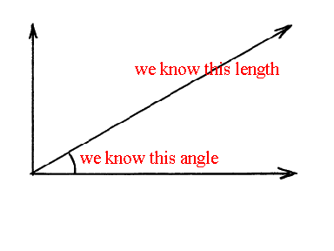
Drawing at an Angle
Notes:
Imagine, for example, that we want to draw a line of d pixels, off at angle a.
This is sort of like Turtle graphics
Assume 0,0 is the origin. Then if you knew x and y of the endpoint, you could use the Graphics::DrawLine(pen,stpt,endpt) command
What are x and y?

Slide 16
Drawing at an Angle
sin(angle) = y / d
cos(angle) = x / d
y = sin(angle) * d
x = cos(angle) * d
Notes:
Let the length of the line we want to draw be d.
The sine and cosine are as defined
We know angle, so can ask the computer for the values of sin(angle) and cosine(angle)
We know d.
Hence we can solve for x and y, via algebra, as shown.
If we are starting from 0,0 we just draw the line to X,Y
If we are starting from any other start point, we just add X to our current x coordinate and Y to our current y coordinate.

Slide 17
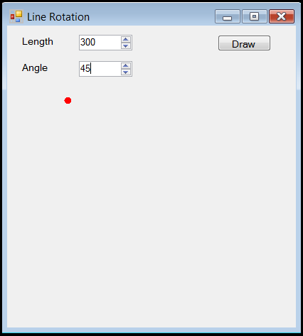
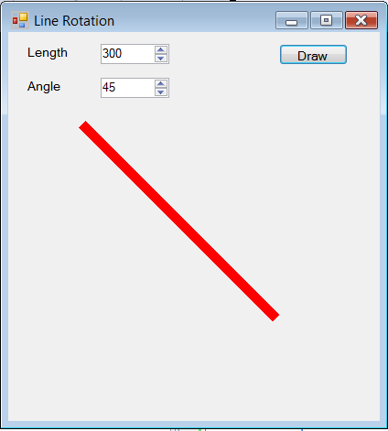
Drawing at an Angle
Notes:
We could build an application like this
You have the start point. You use the equations on the previous slide to compute x and y for a line of length 300 and an angle of 45
That tells you how many pixels to move in the x direction, and how many pixels to move in the y direction
Note that the angle is defined relative to the algebraic number line, where 0 degrees is pointing East, and angle goes clockwise.
Note also that the trig functions are all computed relative to (0,0). Our line doesn’t start at (0,0), it starts at the location of the red dot.
To make this work, we have to “translate” the line. This is just a fancy name for shifting it over by adding a value to x and y.
We’ll see this in the code…..

Slide 18
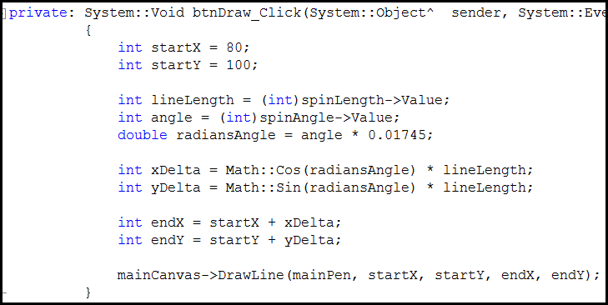
Drawing at an Angle - Code
Notes:
One other thing to note here
Math functions don’t do angles in degrees, they do them in radians. 2*Pi radians = 360 degrees. So you must translate your angle in degrees into some fractional radian, as shown.

Slide 19
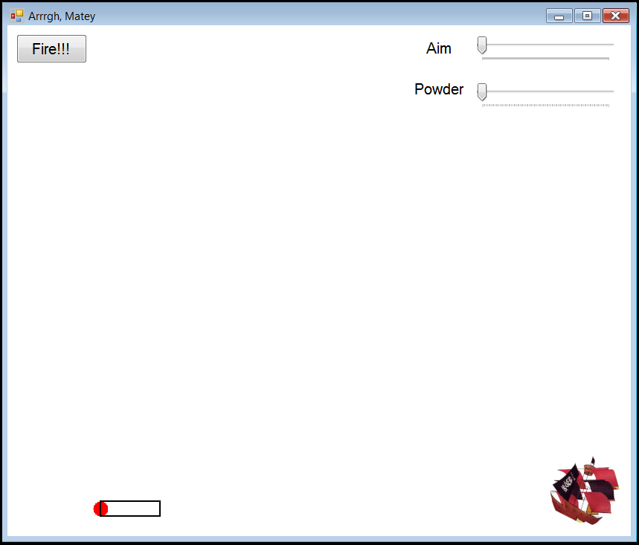
Practical Task 1 - Trajectory
Notes:
We will have two small practical tasks, neither of which use Sprite.
This will allow us to ignore the inheritance issue for now, and just make sure that we understand how to do the trigonometry.
Here is the first task.
We will combine the trajectory algorithm, the rotation algorithm and simple collision detection to build this application (following an example from DelphiForFun).
Rotate the canon with the spin box to determine the angle to launch
Rotate the powder to determine the starting y velocity. The more powder, the greater the velocity. Velocity here is the length of the hypotenuse.
There is a skeleton that provides the UI; you will just need to write the code to set the initial x and y velocities and drive the trajectory.

Slide 20
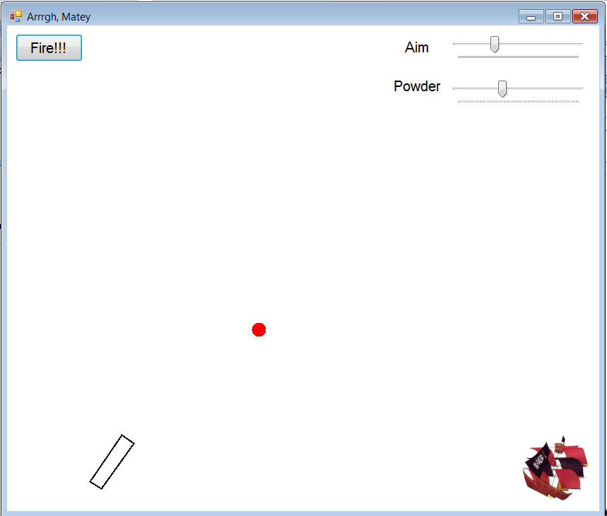
Exercise for Practical
Notes:
Note that we actually rotate –Angle degrees, but it’s mathematically exactly the same
The cannonball must move in the direction of the cannon – i.e. at the rotation angle specified by the Aim trackbar.
Its velocity is set by the Power trackbar. Specifically, the first step the cannonball takes (i.e. its initial xVel and yVel) should move it the distance set on that trackbar.
Thus you need to compute the initial xVel and yVel as the lengths of the legs of the right triangle with angle Aim and hypotenuse length Power.
After that, increment the position of the cannonball at each tick by xVel and yVel, and modify yVal as required to implement gravity, and produce a parabolic trajectory.
If it hits the ship it goes boom.

Slide 21
Starting Velocities
Start the cannonball heading in the direction the cannon is pointing (i.e. at the rotated angle).
Equivalent to drawing a line at that orientation.
The greater the power, the longer the line.
Compute the initial xVel and yVel to produce this motion.

Slide 22
Implementation
Please use the Code Skeleton
Look for ADD CODE HERE
Classes
Implement everything in the Form
Starting Velocities
Use sin and cosine computations
Gravity
Modify yVel as required to implement “gravity”
Collision Detection
Method bool collided() is provided in the skeleton

Slide 23
Orientation
Assume we are at position x,y
Assume our target is at position targetX, targetY.
What angle (from horiztonal) do we need to rotate to “aim” at the target?
If we could determine that angle, we could use the sin/cosine computation to move toward the target at a given speed.
Notes:
When launching, we know the angle and absolute distance we wish to travel, and we calculate the horizontal and vertical components of that movement (i.e. xDelta and yDelta).
A complementary operation is Orientation.
Here, we know the x,y point we want to aim at, and we want to compute the angle from horizontal we would need to rotate to “point” at the target.
We then have a known angle, and could use the sin/cosine equations to work out the xVel and yVel we need to head toward the target.
This is how chase/pursuit is implemented.

Slide 24
Chase/Follow
Computing the angle to the target:
xDelta = target’s xPos – pursuer’s xPos
yDelta = target’s yPos – pursuer’s yPos
angleToTarget = Math::Atan2(xDelta,yDelta)
Approach(target)
xVel = cos(angleTotarget) * speed
yVel = sin(angleTotarget) * speed
xPos += xVel
yPos += yVel
Notes:
We use a new trigonometric function called the arc tangent. In .NET’s math library, the function to compute arctanget is Atan2
It takes the horizontal and vertical distances between two points, and returns the angle of rotation.
Like this…Note that yDelta comes first.
The angle returned is already in radians, so it can be passed directly into the sin and cos functions.
“Speed” here is the length of the hypotenuse, i.e. the length we want to move at each step/timer tick/animation cycle.
We then move using the ordinary (non-directional) movement computation.

Slide 25
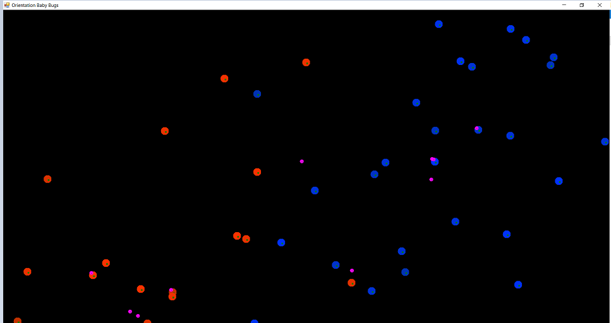
Practical Task 2 - Orientation
Notes:
The pond.
Red bugs and blue bugs wandering around in the pond.
At intervals, the bugs probabilistically spawn some baby bugs (all babies are fuchsia)
Baby bugs follow their parent around for a while, then they grow up and become adult bugs and no longer follow their parent, they just move stochastically like the original bugs.
On the I: drive, you will find a partially completed skeleton for this simulation.
In the skeleton, the baby bugs don’t follow their parent, and there are a few other important bits of functionality missing.
For the second part of today’s practical, you are going to fix the skeleton up.

Slide 26
Practical Task 2 - Orientation
Carefully study the code in OrientationBugsSkeleton2016
Note the technique used to allow circular includes. Could you implement an equivalent architecture without circular includes?
Modify Bug.cpp so that babies follow their parents (as in the demo).
Your pond will soon become so overcrowded that the computer will start to lag. Modify the application so that bugs live a finite amount of time, then die.
Make your extension compatible with the existing architecture
Visually illustrate the age of the bugs in some way.
Make sure dead bugs are removed from the simulation to prevent lag
Notes:
If you like working with the bug simulation, there are lots of things you can add simply by extending the existing architecture and paradigm
For example, you can add fighting. Or you can add food and make spawning dependent on finding food.
Or you can allow each “team” of bug to have different population parameters. You can learn about systems in this way. For example, if you make one team live a long time but breed rarely and in small numbers, and you make the other team live a short time but breed frequently and in large numbers, the short-lived fertile team will take over the world.

